Slide 1




GIT GITHUB WORKSHOP
Manage and Host your projects!
BY : - Meer Tarbani

Slide 2
ROADMAP FOR TODAY’S WORKSHOP
01
02
03
INTRODUNCTION
DIFFERENTIATION
HAND’S ON!
Meaning of Git/GitHub
Difference between Git/GitHub services and use cases!
Drive into Git/GitHub!

Slide 3
WHAT IS GIT ?
Git is a free and open source distributed version control system designed to handle everything from small to very large projects with speed and efficiency.

Slide 4
WHAT IS GitHub ?
GitHub is a WORLD where more than 80 million Developers meet for Hosting, Contributing and Manage their Projects with GIT !

Slide 5
DIFFERENCE : -
GIT
GITHUB
GIT is an OpenSource software that provides service to allow users to manage their projects!
GITHUB is a Platform where Developer meets and contribute code as well as use quality services!

Slide 6
HOW IT WORKS ?
USER
GITHUB
GIT
SERVER

Slide 7
MAIN COMPETITORS
Git Lab
Mercurial
Azure DevOps Server
Aws CodeCommit

Slide 8
SERVICES PROVIDED BY GIT/GITHUB
01

Slide 9

MAIN SERVICES : -
HOSTING
COMMUNITY
DEVELOPMENT ENV

Slide 10
USER BASE : -
OUTREACH
30%
80%
50%
CHINA
USA
INDIA

Slide 11
HANDS ON TIME

Slide 12
OUR PROCESS
INSTALLATION
Pull/Fork
02
04
01
03
CONFIGURE
Commit/Push

Slide 13
FUNCTIONS : -
PUSH
PULL
COMMIT
FORK

Slide 14
200,000,000+
Total Projects

Slide 15
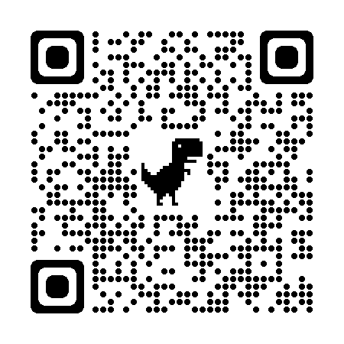
https://github.com

Slide 16
THANK-YOU
Do you have any questions?
admin@rdeclub.live
rdeclub.live
SOCCA

